Slide 1
Proposal:
An approach for identifying microservices using clustering on control flow and data flow
Niko Benkler

Slide 2
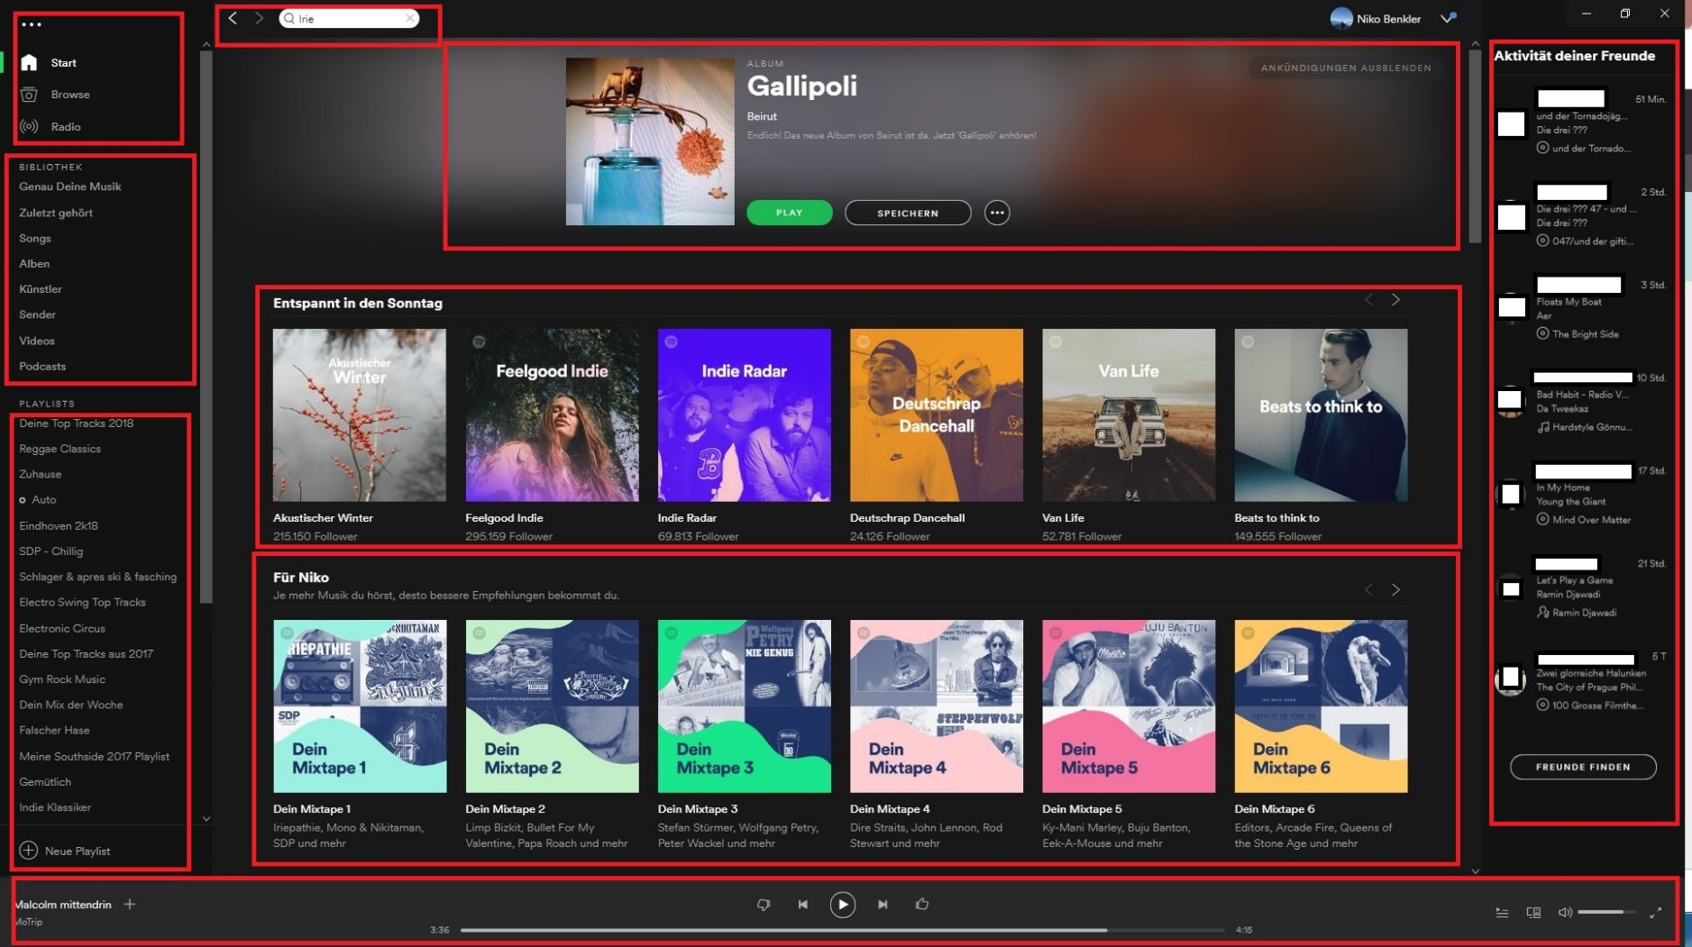

Introductory Example: Spotify
Source: Screenshot, Account of author
Motivation
Foundation
Related Work
Approach
Evaluation
Summary

Slide 3
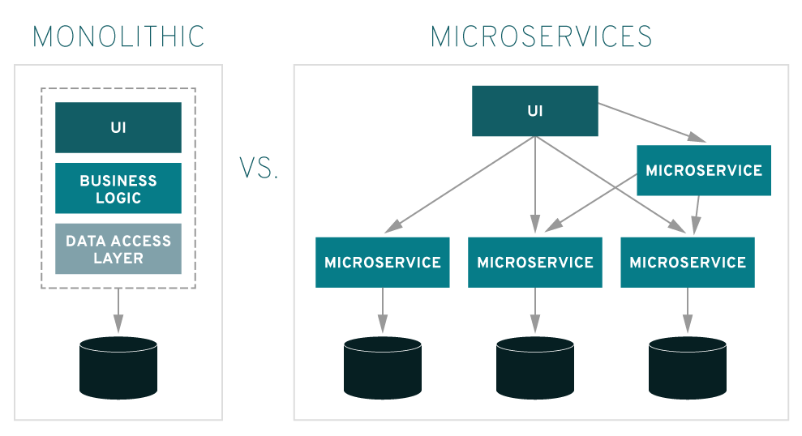
The Architecture - Monolith vs. Microservices
Source: https://www.redhat.com/en/topics/microservices/what-are-microservices
Motivation
Foundation
Related Work
Approach
Evaluation
Summary

Slide 4
Microservices: Benefits and Challenges
Benefits
Independent Deployment
Resilience & Fault Isolation
Improved Scalability
Neutral development Technology
Challenges
Expensive Communication
Infrastructure Automation
Organizational Restructuring
Data Consistency
Microservice Identification
Motivation
Foundation
Related Work
Approach
Evaluation
Summary

Slide 5
PIBA
Problem
Migrate a monolithic architecture to a microservice-based system
Idea
Identify microservices using clustering on control flow and data flow
Benefit
Faster identification process
Reduce required expertise and manual effort
Create more adequate microservices
Action
Identify possible structural and data object dependencies
Create separate clusters by using the dependencies as weights
Match set of clusters to generate possible microservice candidates
Motivation
Foundation
Related Work
Approach
Evaluation
Summary

Slide 6
Microservice Identification … so far!
Complex and highly manual task
Needs experienced system architects and domain experts
Mainly intuitively and based on experience/knowledge
Risks:
Too fine grained: Inefficient due to expensive inter-service calls
Too coarse grained: Loss of scalability and Independence
Formal approach to identify microservices is required
Motivation
Foundation
Related Work
Approach
Evaluation
Summary

Slide 7
Research Questions
RQ1: Which is the most appropriate strategy to extract microservices from a monolithic system?
Literature research, compare based on criteria
RQ2: What formal approach can be constructed to perform the extraction process without detailed know-how and manual effort?
Use most adequate strategy from RQ1 as basis for new approach
Elaborate new approach
RQ3: What is the quality of the microservices recommended by the approach?
Apply to CoCoME and compare with manual decomposition and paper
Motivation
Foundation
Related Work
Approach
Evaluation
Summary

Slide 8
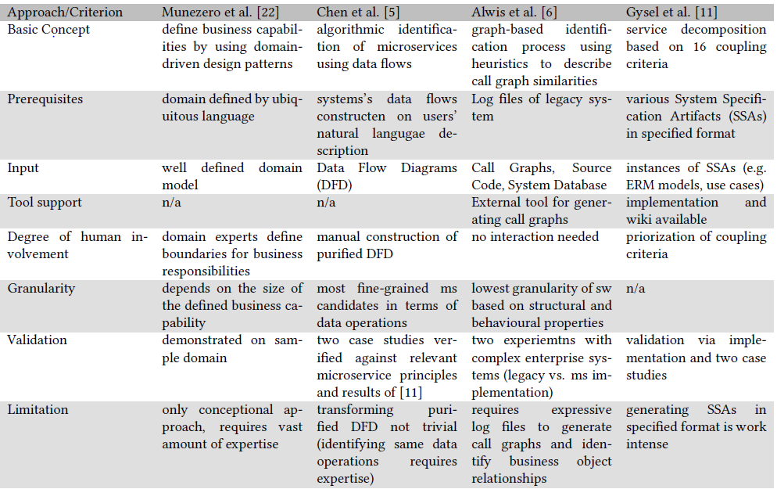
Approaches I
Motivation
Foundation
Related Work
Approach
Evaluation
Summary

Slide 9
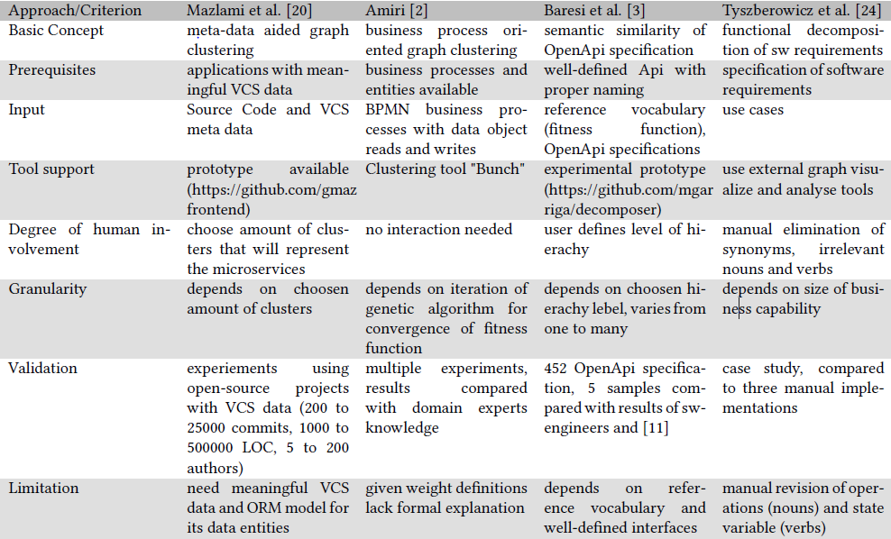
Approaches II
Motivation
Foundation
Related Work
Approach
Evaluation
Summary

Slide 10
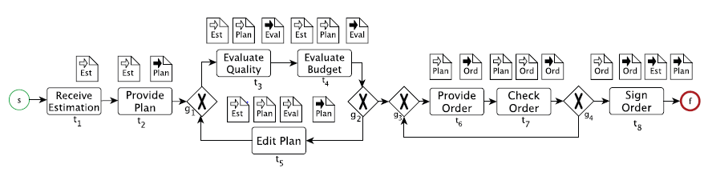
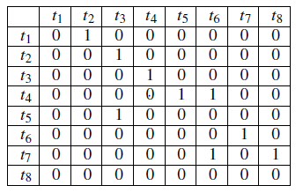
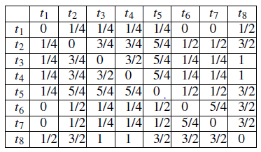
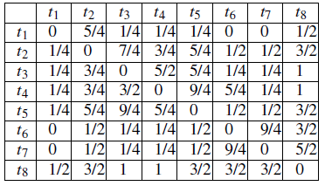
Basic Approach: Object-aware Identification of Microservices
BPMN Graph:
Structural Dependency
Data Object Dependency
Clustering
Aggregation
Microservice candidates
Sources: Object-aware Identification, M.J. Amiri
Motivation
Foundation
Related Work
Approach
Evaluation
Summary

Slide 11
Weakness
Aggregation lacks mathematical evidence
Weighting for read/write access does not consider inter-/intra service calls
Remote calls outweigh difference between read and write access
Data flow only implicitly
Blurred data- and control flow
Motivation
Foundation
Related Work
Approach
Evaluation
Summary

Slide 12
Contributions
Separate data object dependency and structural dependency
Cluster based on structural dependency as proposed
Cluster for object dependency based on new
Circumvent ambiguity of aggregation process
New approach for Object dependency:
Distance Measure
Amount activities that access pair of objects
…
Match both set of clusters
Based on BPMN Model information
Merge & split possible
Motivation
Foundation
Related Work
Approach
Evaluation
Summary

Slide 13
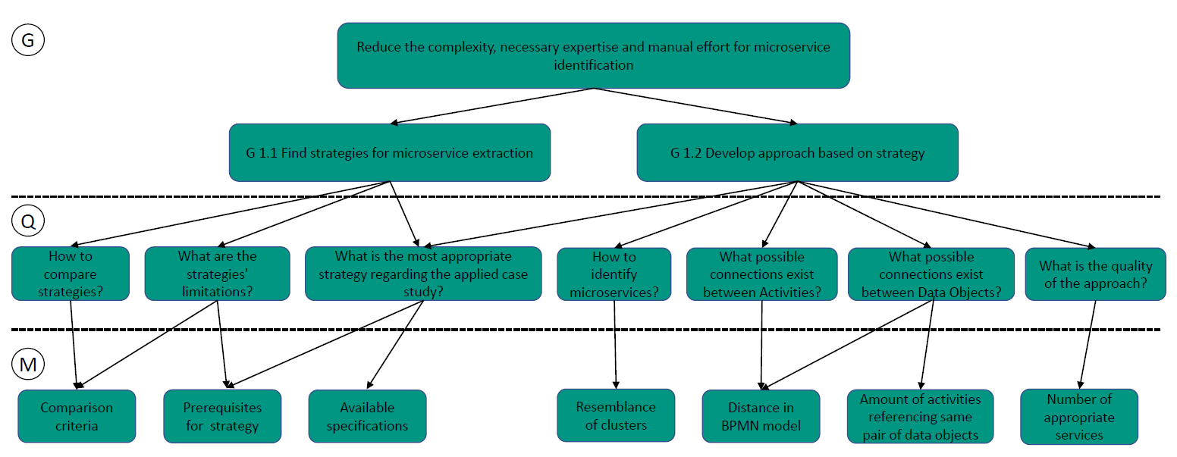
Evaluation: GQM-Plan
Source: Identifying Microservices Using Functional Decomposition, S. Tyszberowicz
Motivation
Foundation
Related Work
Approach
Evaluation
Summary

Slide 14
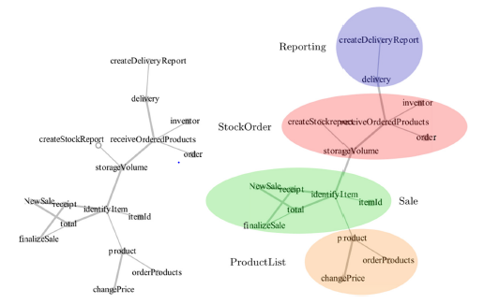
Evaluation: Results
Apply to case study CoCoME
Evaluate results
Amount of similar microservices
Assess the quality of the other identified services
Evaluate limitations
Provide outlook
Source: Identifying Microservices Using Functional Decomposition, S. Tyszberowicz
Motivation
Foundation
Related Work
Approach
Evaluation
Summary

Slide 15
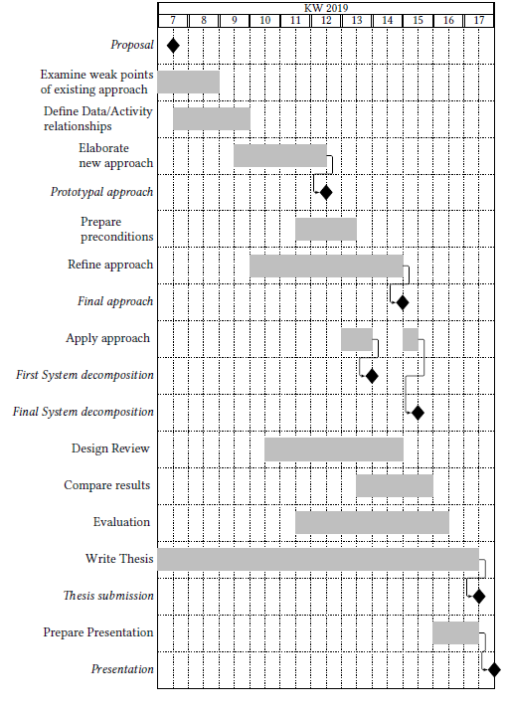
Summary
Motivation
Foundation
Related Work
Approach
Evaluation
Summary

Slide 16
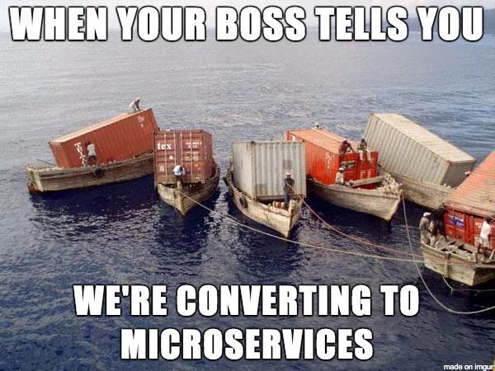
Source: https://twitter.com/shanselman/status/785985307816493057

